Slide 1
ECE5584 – Digital Image Processing Homework 3 Fall 2019
By Matthew Kayrish

Slide 2
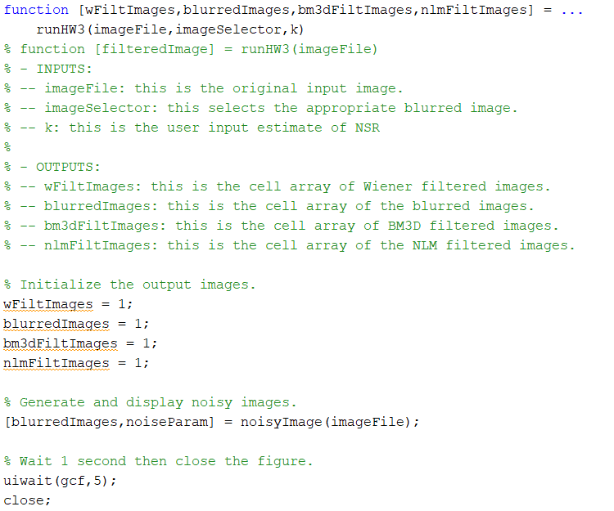
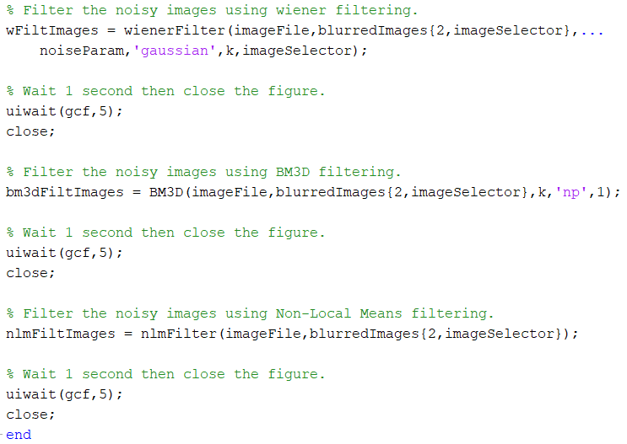
Top-Level runHW3.m Code

Slide 3

Original Image: Lena

Slide 4
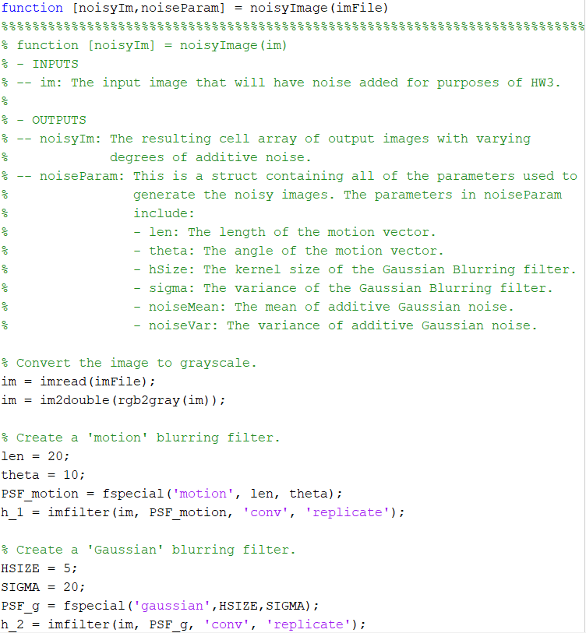
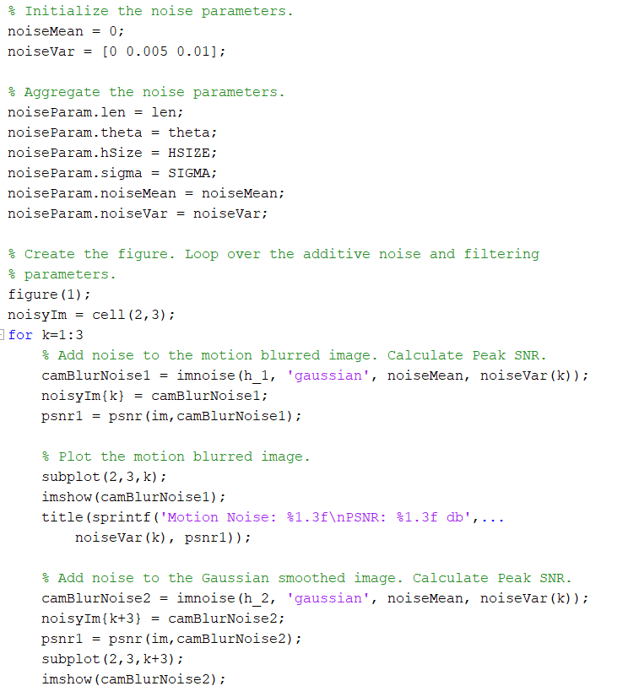
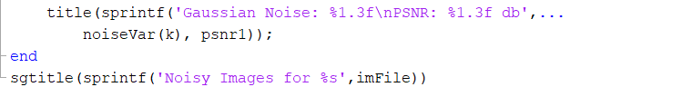
Generate Noisy Images
” Use noisyImage.m to generate blurry images as input of following questions. Then deblur with filters we introduced during class.”

Slide 5
Problem 1: Wiener Filtering
”Use Wiener filter to denoise and deblur the 6 noisy images. Adjust the value of parameter k (noise to signal power ratio parameter) and choose the appropriate value for the filter. Finally, use the correlation model spectrum to compute wiener filtering. (60 points)
Hint: [reconstructed image] = deconvwnr(image, noisy image, k)
Estimate the value of NSR.
Use the correlation model (k=noise_var/image_var).
Compare PSNR of each configuration for wiener filtering.
Analyze the results.”

Slide 6
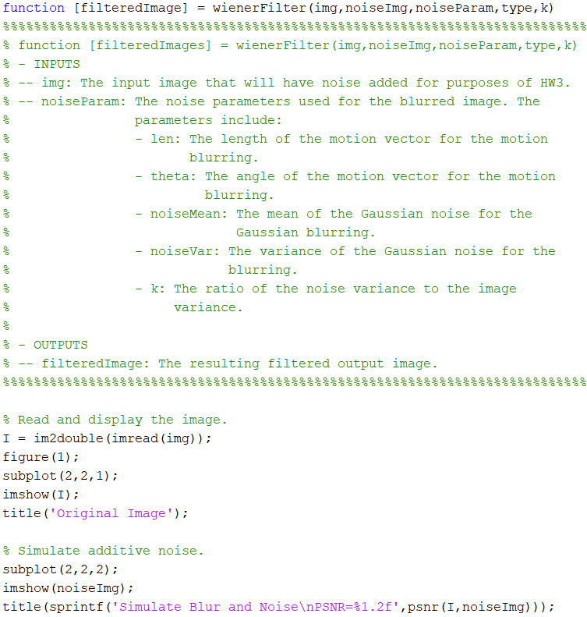
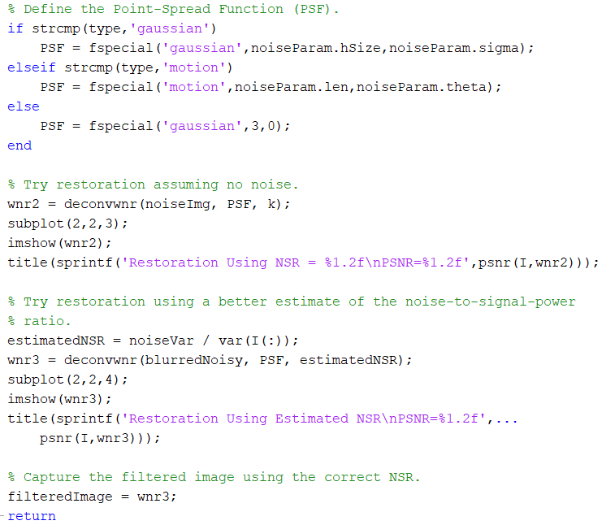
Problem 1: Weiner Filtering

Slide 7
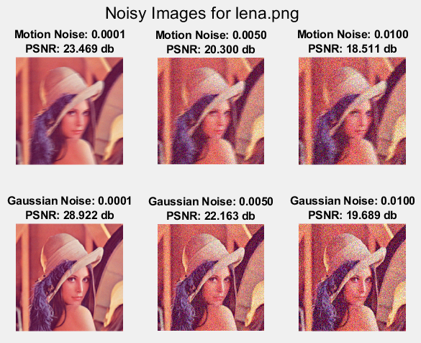
Generate Noisy Images: “Lena”

Slide 8
Problem 1: Wiener Filtering Results
Blur Type | Additive Noise | Optimal NSR | Estimated SNR | Restored PSNR
Motion | Mean = 0 Var = 0 | 0.0355 | 0.0019 | 24.00
Motion | Mean = 0 Var = 0.005 | 0.08 | 0.0935 | 21.10
Motion | Mean = 0 Var = 0.01 | 0.0990 | 0.1869 | 20.01
Gaussian | Mean = 0 Var = 0 | 0.0350 | 0.0019 | 27.71
Gaussian | Mean = 0 Var = 0.005 | 0.0950 | 0.0935 | 21.81
Gaussian | Mean = 0 Var = 0.01 | 0.1180 | 0.1869 | 20.31

Slide 9
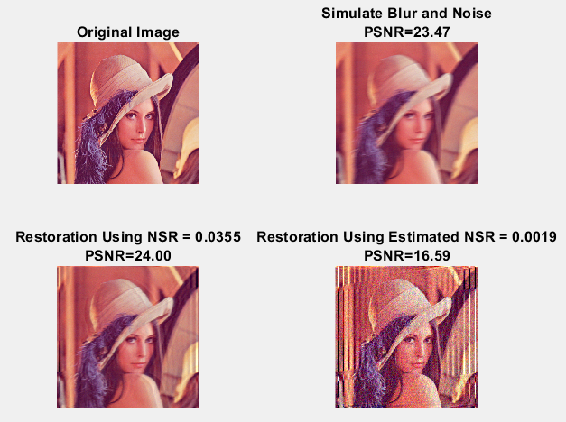
Problem 1: Wiener Filtering
Conditions:
PSF Used: Motion
Padding: Replicate Edges
Length = 20 pixels
Theta = 10 degrees
Noise Mean = 0
Noise Variance = 0.0001
k_{optimum} = 0.0355
Estimated NSR = 0.0019

Slide 10
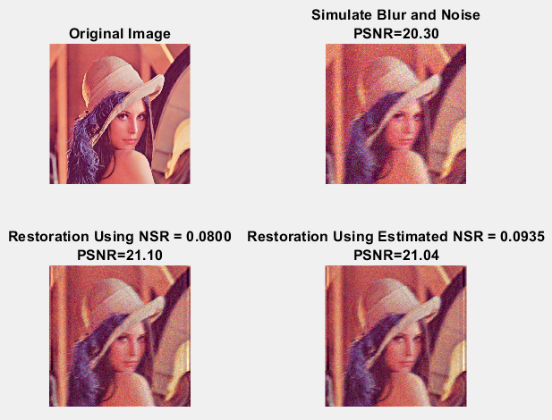
Problem 1: Wiener Filtering
Conditions:
PSF Used: Motion
Padding: Replicate Edges
Length = 20 pixels
Theta = 10 degrees
Noise Mean = 0
Noise Variance = 0.005
k_{optimum} = 0.08
Estimated NSR = 0.0935

Slide 11
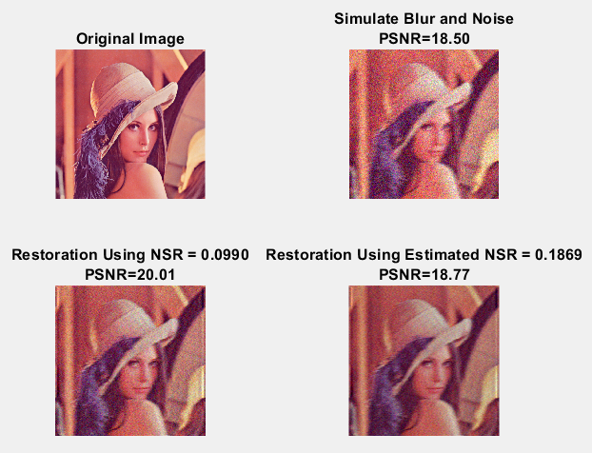
Problem 1: Wiener Filtering
Conditions:
PSF Used: Motion
Padding: Replicate Edges
Length = 20 pixels
Theta = 10 degrees
Noise Mean = 0
Noise Variance = 0.01
k_{optimum} = 0.099
Estimated NSR = 0.1869

Slide 12
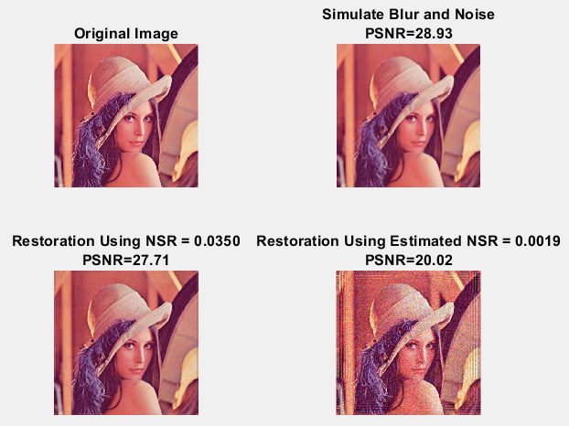
Problem 1: Wiener Filtering
Conditions:
PSF Used: Gaussian
Filter Size: 5x5
Sigma: 20
Padding: Replicate Edges
Noise Mean = 0
Noise Variance = 0.0001
k_{optimum} = 0.035
Estimated NSR = 0.0019

Slide 13
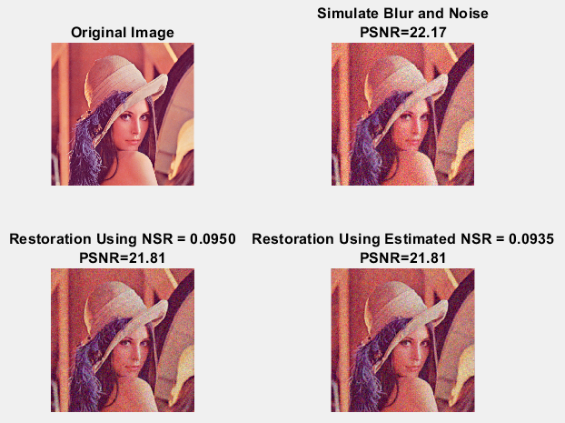
Problem 1: Wiener Filtering
Conditions:
PSF Used: Gaussian
Filter Size: 5x5
Sigma: 20
Padding: Replicate Edges
Noise Mean = 0
Noise Variance = 0.005
k_{optimum} = 0.095
Estimated NSR = 0.0935

Slide 14
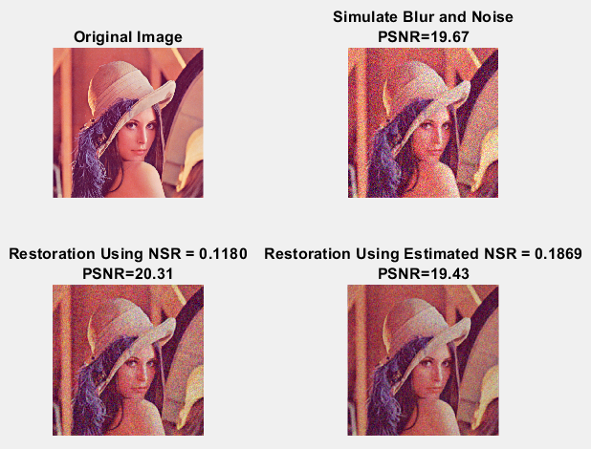
Problem 1: Wiener Filtering
Conditions:
PSF Used: Gaussian
Filter Size: 5x5
Sigma: 20
Padding: Replicate Edges
Noise Mean = 0
Noise Variance = 0.01
k_{optimum} = 0.118
Estimated NSR = 0.187

Slide 15
Problem 1: Wiener Filtering Discussion
The Wiener Filter is effective at removing the motion distortion of images.
The Wiener Filter is not as effective at removing Gaussian Noise from images.
The PSNR of the recovered image is slightly increased over the noisy images.
The original image quality is not always recovered, especially when the Gaussian noise is heavy.
Adjusting the ’k’ value is effective for finding the optimal qualitative improvement.
Edge information seemed to be recovered pretty well.
The best filter would be where the Wiener filter is combined with a smoothing filter for removing random noise.

Slide 16
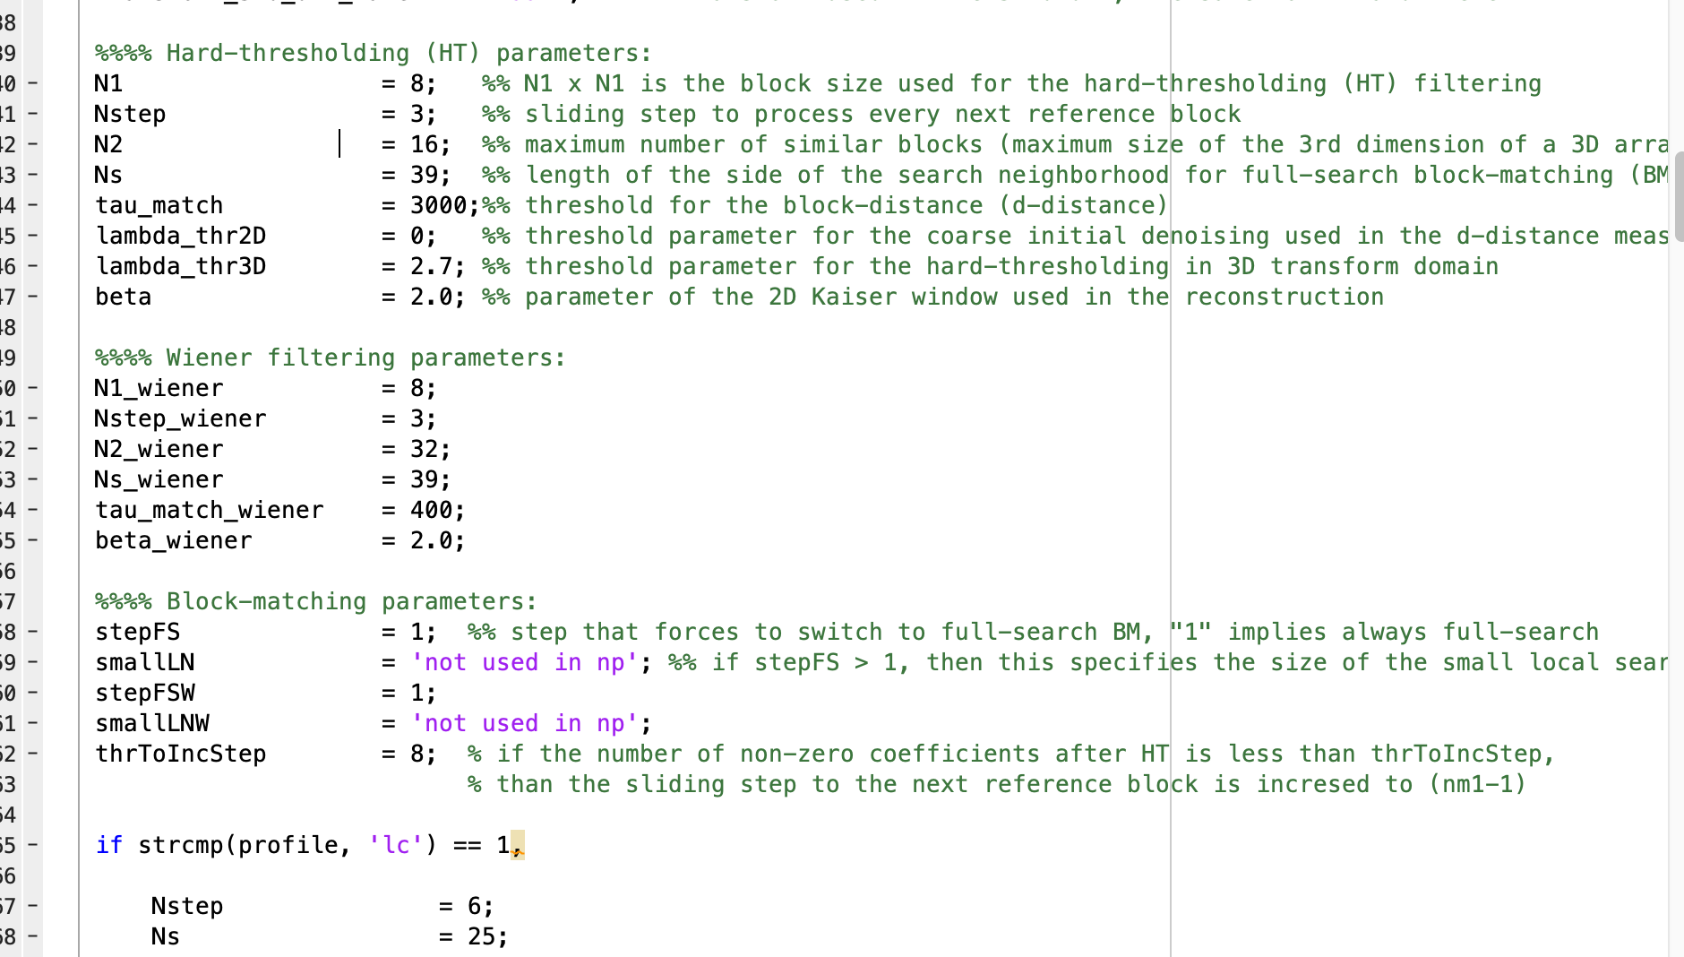
Problem 2: BM3D Filtering
“Use BM3D to denoise and deblur the given noisy images. (40 points) Hint: open source http://www.cs.tut.fi/~foi/GCF-BM3D/). BM3D.m is for grayscale image BM3D deblurring.
Adjust the value of implemented block size N1 and N1_Weier simultaneously (default: N1= N1_Weier=8)
Compare PSNR of each configuration for BM3D.
Analyze the results.”

Slide 17
Problem 2: BM3D Filtering Results
Blur Type | Additive Noise | Sigma | Noisy PSNR | Restored PSNR
Motion | Mean = 0 Var = 0 | 15 | 23.27 | 23.315
Motion | Mean = 0 Var = 0.005 | 20 | 21.63 | 23.29
Motion | Mean = 0 Var = 0.01 | 20 | 20.45 | 23.21
Gaussian | Mean = 0 Var = 0 | 15 | 29.48 | 29.21
Gaussian | Mean = 0 Var = 0.005 | 12 | 24.85 | 29.08
Gaussian | Mean = 0 Var = 0.01 | 16 | 22.72 | 28.70

Slide 18
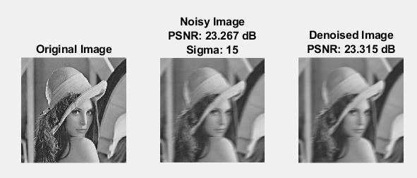
Problem 2: BM3D Filtering
Conditions:
PSF Used: Motion
Padding: Replicate Edges
Length = 20 pixels
Theta = 10 degrees
Noise Mean = 0
Noise Variance = 0.0001
Block Size (N1) = 8
N1_Wiener = 8
Sigma = 15

Slide 19
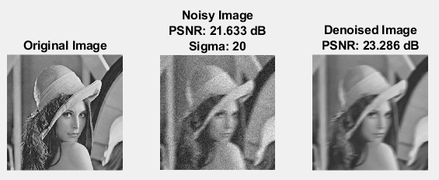
Problem 2: BM3D Filtering
Conditions:
PSF Used: Motion
Padding: Replicate Edges
Length = 20 pixels
Theta = 10 degrees
Noise Mean = 0
Noise Variance = 0.005
Block Size (N1) = 8
N1_Wiener = 8
Sigma = 20

Slide 20
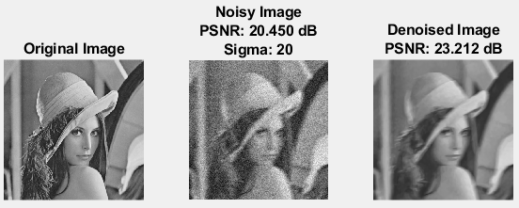
Problem 2: BM3D Filtering
Conditions:
PSF Used: Motion
Padding: Replicate Edges
Length = 20 pixels
Theta = 10 degrees
Noise Mean = 0
Noise Variance = 0.01
Block Size (N1) = 8
N1_Wiener = 8
Sigma = 20

Slide 21
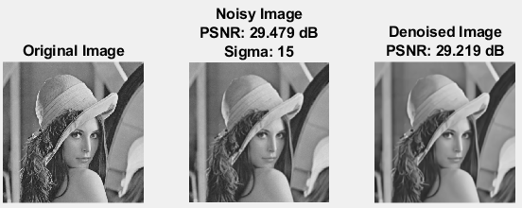
Problem 2: BM3D Filtering
Conditions:
PSF Used: Gaussian
Filter Size: 5x5
Sigma: 20
Padding: Replicate Edges
Noise Mean = 0
Noise Variance = 0.0001
Block Size (N1) = 8
N1_Wiener = 8
Sigma = 15

Slide 22
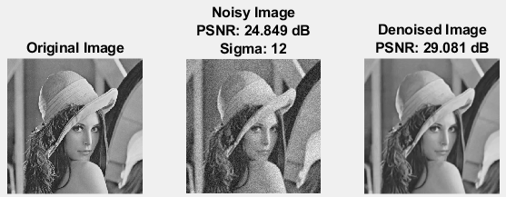
Problem 2: BM3D Filtering
Conditions:
PSF Used: Gaussian
Filter Size: 5x5
Sigma: 20
Padding: Replicate Edges
Noise Mean = 0
Noise Variance = 0.005
Block Size (N1) = 8
N1_Wiener = 8
Sigma = 12

Slide 23
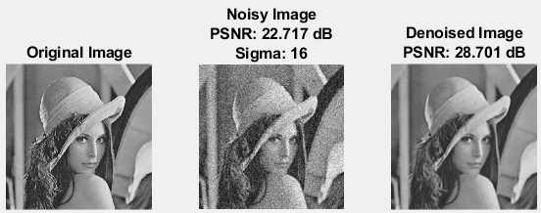
Problem 2: BM3D Filtering
Conditions:
PSF Used: Gaussian
Filter Size: 5x5
Sigma: 20
Padding: Replicate Edges
Noise Mean = 0
Noise Variance = 0.01
Block Size (N1) = 8
N1_Wiener = 8
Sigma = 16

Slide 24
Problem 2: BM3D Filtering Discussion
The BM3D Filter is effective at removing the random Gaussian noise in the images.
The BM3D Filter is not as effective at removing the motion distortion from the images.
The PSNR of the recovered image is highly increased over the noisy images.
The original image quality is not always recovered, especially when the noise distortion is heavy.
BM3D filtering is effective for smoothing out noise in an image.
This filter would combine well with a Wiener Filter for removing both noise and motion.
As sigma increases, the recovered quality improves to a peak, then slowly degrades. This is caused by oversmoothing.

Slide 25
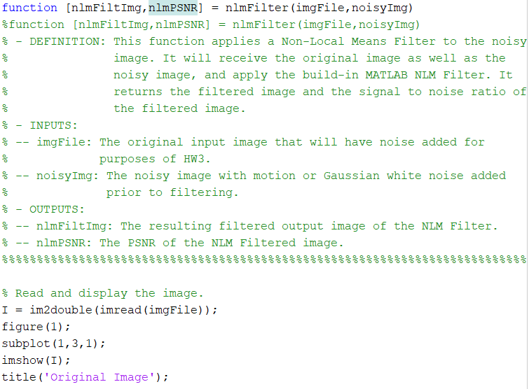
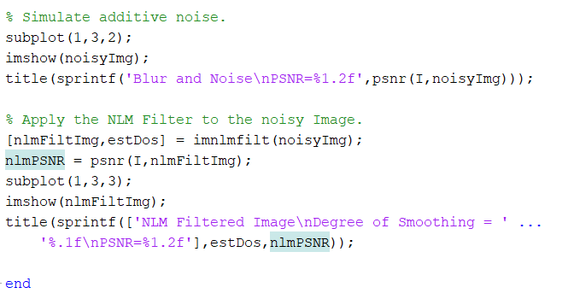
Bonus: Non Local Means Filtering
“Bonus: Implement the non-local means (NLM) filter on our given blurry images and calculate corresponding restricted PSNR. Show your codes and results. Analyze them and give a conclusion. (20 points extra)”

Slide 26
Bonus: Non Local Means Filtering Results
Blur Type | Additive Noise | Estimated DoS | Noisy PSNR | Restored PSNR
Motion | Mean = 0 Var = 0 | 0.0 | 23.47 | 23.48
Motion | Mean = 0 Var = 0.005 | 0.1 | 20.29 | 22.00
Motion | Mean = 0 Var = 0.01 | 0.1 | 20.45 | 23.21
Gaussian | Mean = 0 Var = 0 | 0.0 | 28.93 | 28.98
Gaussian | Mean = 0 Var = 0.005 | 0.1 | 22.16 | 24.73
Gaussian | Mean = 0 Var = 0.01 | 0.1 | 19.68 | 23.13

Slide 27
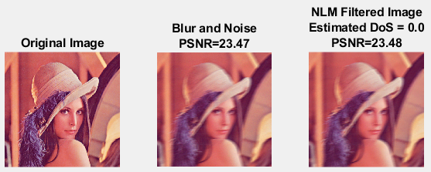
Bonus: Non-Local Means Filtering
Conditions:
PSF Used: Motion
Padding: Replicate Edges
Length = 20 pixels
Theta = 10 degrees
Noise Mean = 0
Noise Variance = 0.0001

Slide 28

Bonus: Non-Local Means Filtering
Conditions:
PSF Used: Motion
Padding: Replicate Edges
Length = 20 pixels
Theta = 10 degrees
Noise Mean = 0
Noise Variance = 0.005

Slide 29
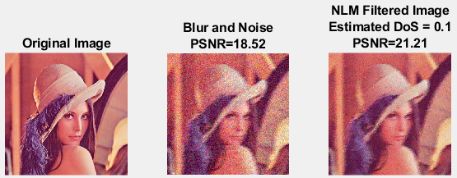
Bonus: Non-Local Means Filtering
Conditions:
PSF Used: Motion
Padding: Replicate Edges
Length = 20 pixels
Theta = 10 degrees
Noise Mean = 0
Noise Variance = 0.01

Slide 30
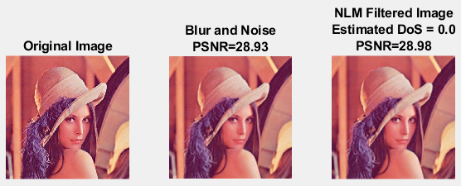
Bonus: Non-Local Means Filtering
Conditions:
PSF Used: Gaussian
Filter Size: 5x5
Sigma: 20
Padding: Replicate Edges
Noise Mean = 0
Noise Variance = 0.0001

Slide 31

Bonus: Non-Local Means Filtering
Conditions:
PSF Used: Gaussian
Filter Size: 5x5
Sigma: 20
Padding: Replicate Edges
Noise Mean = 0
Noise Variance = 0.005

Slide 32
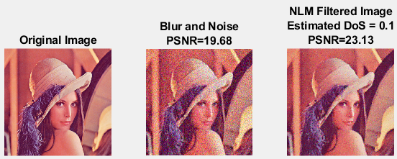
Bonus: Non-Local Means Filtering
Conditions:
PSF Used: Gaussian
Filter Size: 5x5
Sigma: 20
Padding: Replicate Edges
Noise Mean = 0
Noise Variance = 0.01

Slide 33
Bonus: NLM Filtering Discussion
The NLM Filter is effective at removing the random Gaussian noise in the images.
The NLM Filter is not as effective at removing the motion distortion from the images.
The PSNR of the recovered image is increased over the noisy images, but not to the same extent of the BM3D filter.
The original image quality is not always recovered, especially when either the noise or motion distortion is heavy.
The NLM filtering appears to combine to an extent both the Wiener filter and the BM3D filter as it recovers some of the noise and motion distortion, though not as well as either of those filters.
The smoothing effect of this filter seems to remove some of the edges of the image.

Slide 34
Conclusion
Wiener Filter
BM3D Filter
NLM Filter
Most effective for removing motion distortion from images
Not as effective as the BM3D filter for removing noise from images
Most Effective for removing noise from images
Not as effective as the Wiener filter for removing motion distortion from images
Provides some recovery for both noise and motion distortion
Not as effective as Wiener filter for motion recovery
Not as effective as BM3D for noise recovery
Suffers from excessive smoothing and edge destruction.

